Slide 1
By: Lara Tarkh Abeer Alolabi Samar Moussa
Perfumalize

Slide 2
Outline:
Outcomes and challenges
The project ”Perfumalize”
Personal Analysis
The way we created it
The overview website

Slide 3
Challenges:
Changing the idea
Logistical obstacles
Technical challenges( using bootstrap)

Slide 4

Outcomes:
Learning basics of front-end.
Putting into action
Meeting powerful community.
Improving soft skills

Slide 5
What is Perfumalize?
Friendly simple website
Analyzing your personality

Slide 6

Are You?
Into Citrus scents like Adidas?

Slide 7
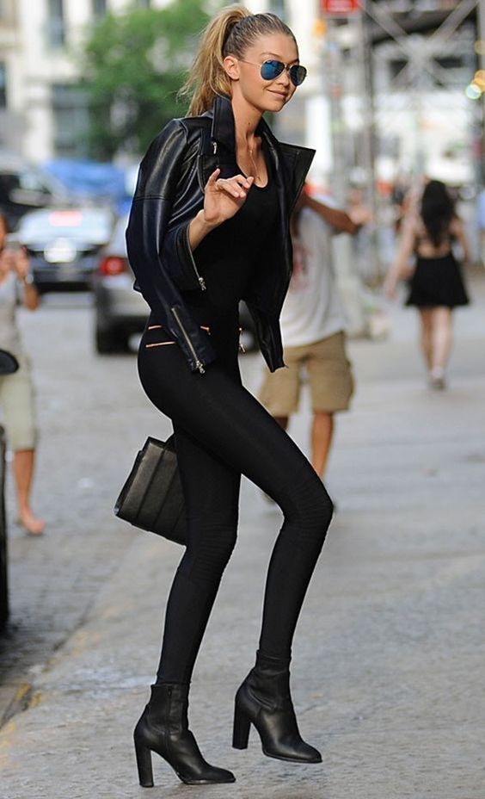
Or…
Are you a fan of Black Opium style?

Slide 8
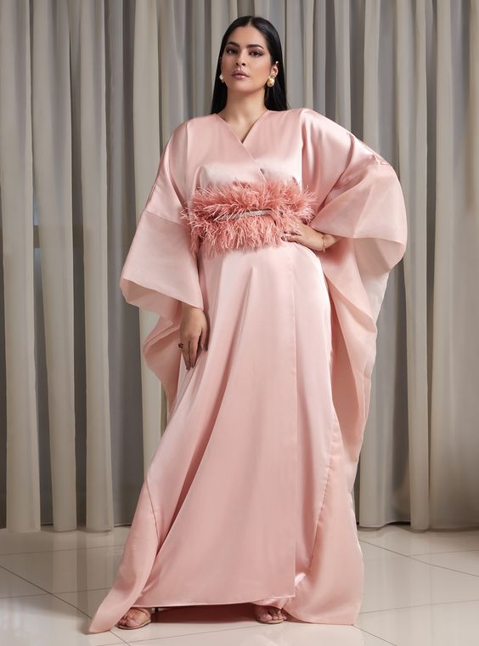
Are You?
Into Woody Scents like Coco Channel ?

Slide 9

Or..
Floral Scents like Daisy Marc Jacobs?

Slide 10
How we created Perfumalize?
HTML for the content.
CSS for the design.
Bootstrap for the analysis.
JavaScript for some functionality.
HTML ,CSS
JS ,bootstrap

Slide 11
Our Site Map:
Perfumalize
Analysis
About Us
Main Page
Floral
Woody
Oriental
Citrus

Slide 12
Perfumalize overview

Slide 13
Thank you for your attention!

